Slide 1
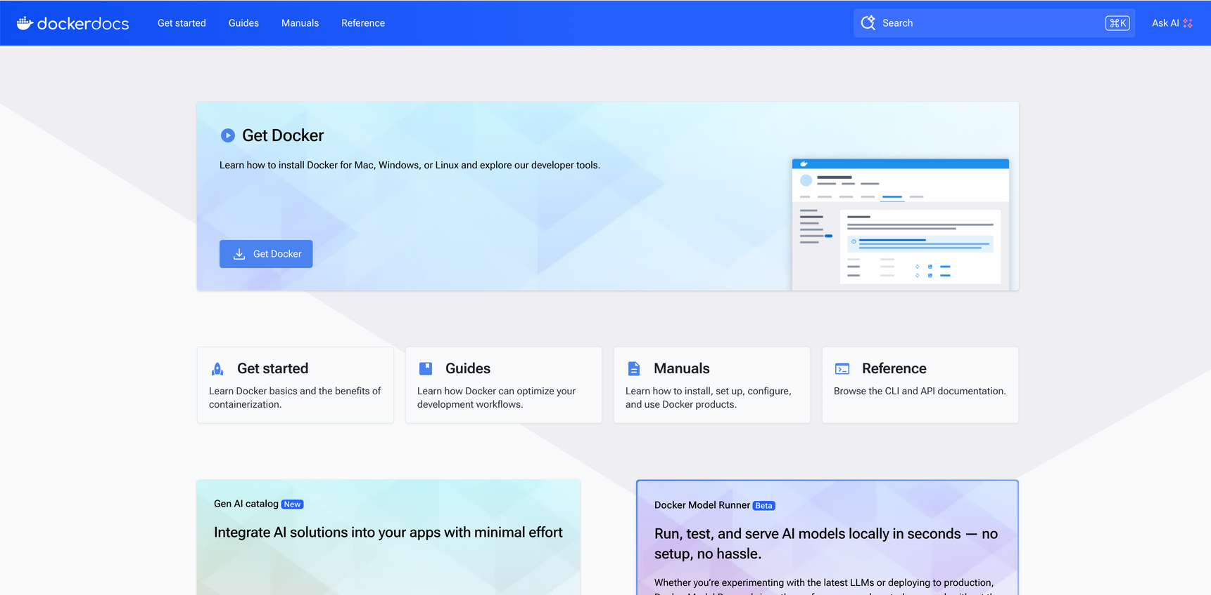
Docker

Slide 2
Agenda
Containers
Docker Architecture
Building docker images with Dockerfile
Docker Hub & Registry
Docker networking
Docker volumes
Docker compose
Docker as our local development environment

Slide 3
Docker
Docker is an open platform for developing, shipping, and running applications.
Docker allows you to package an application with all of its dependencies into a standardized unit for software development.

Slide 4
Docker Containers VS Virtual machines
Docker is a lightweight way to run apps in isolated environments, using the same OS kernel
Shares the host OS (e.g., Linux) → super fast.
Uses images for quick startup.
Isolated but not as heavy as a VM.
Built for microservices, automation, and DevOps.
Starts in seconds.
Notes:
דמיין שאתה לוקח מחשב אחד — וגורם לו "להתחלק" ל-5 מחשבים נפרדים שפועלים במקביל, כאילו הם מחשבים אמיתיים, עם מערכת הפעלה, קבצים, רשת וכולי.
ה-Hypervisor הוא זה שמנהל את כל זה.
הוא "יושב" בין החומרה של המחשב לבין מערכות ההפעלה של המכונות הווירטואליות.

Slide 5
Docker Containers VS Virtual machines
A VM simulates an entire computer, including its own OS, kernel, memory, and CPU.
Runs on a hypervisor (like VMware, VirtualBox, or Hyper-V).
Each VM has its own OS (Windows, Linux, etc.).
Heavyweight – takes more memory and storage.
Slower to start (can take minutes).
Strong isolation – more secure, but more resource-hungry.

Slide 6
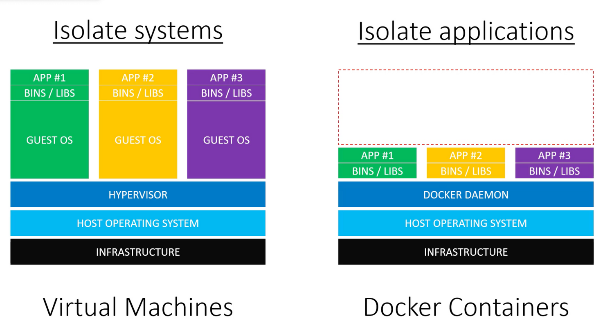
Docker Containers VS Virtual machines
Virtual Machines
Containers
‹#›
© All rights reserved to John Bryce Training LTD from Matrix group

Slide 7
Docker Advantages
Small to tiny images
Very small footprint on the host machine (CPU, RAM Impact) as Docker only use what it required instead of building a complete Operating system per VM.
Containers use up only as many system resources as they need at a given time. VMs usually require some resources to be permanently allocated before the virtual machine starts.
Microservice in nature and integrations (API’s) for whatever task required.
Portable, Fast (Deployments , Migration , Restarts and Rollbacks) and Secure
Can run anywhere and everywhere
Simplify DevOps
Version controlled
Open Source

Slide 8
Common Use Cases for Docker
CI / CD
Fast Scaling application layers for overcoming application performance limitations.
For Sandboxed environments (Development, Testing , Debugging)
Local development environment ( no more “it works for me” )
Infrastructure as a CODE made easy with docker
Multi-Tier applications (Front End , Mid Tier (Biz Logic) , Data Tier) / Microservices
Building PaaS , Saas

Slide 9
Docker Architecture

Slide 10
Under The Hood
Architecture: Linux X86-64
Written in: GoLang ( On March 13, 2014, with the release of version 0.9, Docker dropped LXC as the default execution environment which is an operating system level virtualization and replaced it with its own libcontainer library written in the Go programming language )
Engine: Client - Server (Daemon) Architecture
Namespace: Isolation of process in linux where one process cant “See” the other process
Control Groups: Linux Kernel capability to limit and isolate the resource usage (CPU, RAM, disk I/O, network etc..) of a collection of process
Container format: libcontainer - Go implementation for creating containers with namespaces, control groups and File system capabilities access control

Slide 11

Docker Architecture

Slide 12
What is docker - technical aspect
Client - Server Architecture
Client talks with the Docker Daemon
Docker Daemon do the heavy part: Building, Running and distributing Docker Containers.
Most of the cases the Daemon and the Client run on the same system
There are some cases the Client will connect to a remote Docker daemon, the communication will be made by Rest API, over UNIX sockets or network interface.

Slide 13
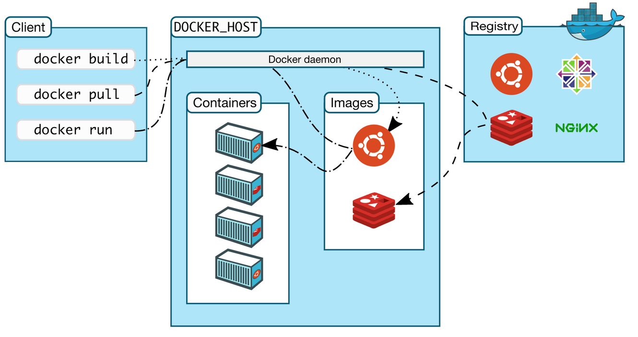
Docker Architecture

Slide 14
Docker Components
Engine
Daemon
(Docker) Client
Docker Registries
Docker Objects
Machine
Compose

Slide 15
Docker Components - Engine
A server which is a type of long-running program called a daemon process (the dockerd command).
A REST API which specifies interfaces that programs can use to talk to the daemon and instruct it what to do.
A command line interface (CLI) client (the docker command).

Slide 16
Docker Components - Daemon
It’s the main background process that runs on your system.
Listens for Docker API requests (from CLI or SDKs).
Creates, manages, and runs containers.
Binary name: dockerd.

Slide 17
Docker Components - Client
The Docker client (docker) is the primary way that many Docker users interact with Docker. When you use commands such as docker run, the client sends these commands to dockerd, which carries them out. The docker command uses the Docker API.
Docker client can communicate with more than one Daemon
Ex - Docker Desktop / Rancher Desktop

Slide 18
Docker Components - Registry
A Docker registry stores Docker images. Docker Hub and Docker Cloud are public registries that anyone can use, and Docker is configured to look for images on Docker Hub by default. You can even run your own private registry.
When one use “docker pull / push / run” commands, the required images are pulled from the configured registry.

Slide 19
Docker Components - Docker Objects
Images
Read Only template with instruction for creating a Docker Container. Often, an Image is based on another image with some additional customization.
Self own images that are fully created by you using DockerFile with a simple syntax where every instruction control a different Layer in the image. Once a change is made to a specific layer, a rebuild of the image will change only the updated layers. This what makes images small, fast and lightweight in compared to other virtualization solutions

Slide 20
Docker Components - Docker Objects
Containers
A container is a runnable instance of an image. You can create, start, stop, move, or delete a container using the Docker API or CLI. You can connect a container to one or more networks, attach storage to it, or even create a new image based on its current state.
Container is defined by its image as a well as any configuration options we provide to it when created or when we start it

Slide 21
Docker Components - Docker Objects
Services
Allow you to scale containers across multiple Docker daemons, which all work together as a swarm with multiple managers and workers. Each member of a swarm is a Docker daemon, and the daemons all communicate using the Docker API. A service allows you to define the desired state, such as the number of replicas of the service that must be available at any given time. By default, the service is load-balanced across all worker nodes. To the consumer, the Docker service appears to be a single application. Docker Engine supports swarm mode in Docker 1.12 and higher.

Slide 22
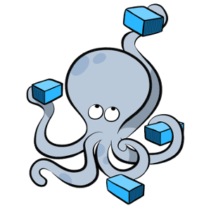
Docker Components - Compose
A tool for defining and running complex applications with Docker (eg multi-container application )
With a single configuration file

Slide 23
Working with Docker
Access your machine
PORT 5000
PORT 5001 VsCode - password: devopshift

Slide 24
Keywords
Docker deamon – the main process we need to run to get all the capabilities of docker on our machine – CPU
Docker hub – the main public registry supply availble images and docker files.
Docker file – set of instructions for building an image ( file name convention: dockerfile)
Docker image – the output from building docker file, reusable asset, contains code, environment variables etc.
Docker Container - virtualized runtime environment used in application development It is used to create, run and deploy applications that are isolated from the underlying hardware

Slide 25
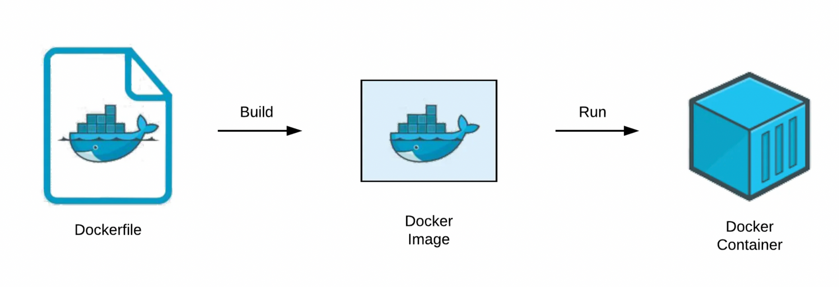

Slide 26
Working methods
Running Containers from existing Docker image ( based on docker hub ) changing the container environment with series of steps and saving the result in a new image
By constructing a plain-text file, known as a Dockerfile, which provides the specifications for creating a Docker image, usually using the keyword “From” in docker file to base our image on other exiting image in the chain.

Slide 27
Lets try things out
Running the following command will download MySQL docker image and Run it.
The Image will be downloaded from Docker Hub, and running the container in your machine
docker run --name mysql-container-test -e MYSQL_ROOT_PASSWORD=my-secret-pw -d mysql

Slide 28
Docker Flow
docker run --name mysql-container-test -e MYSQL_ROOT_PASSWORD=my-secret-pw -d mysql
‘docker run’ will run the container
This will not restart an already running container, just create a new one
docker run [options] IMAGE [command] [arguments]
[options] modify the docker process for this container
IMAGE is the image to use
[command] is the command to run inside the container (entry point to hold the container running)
[arguments] are arguments for the command

Slide 29
What Actually happened?
Pulls the MySQL Latest image from the registry (if not existed on our station)
Run “docker images” to see what images already downloaded / in use locally
Creates new container
Allocate FS and Mounts a read-write Layer
Allocates network/bridge interface
Set up an IP Address
Executes a process that we specify (in this scenario - “sh” as alpine release doesn't have bash)
Captures and provides application outputs

Slide 30
Commands
Run the following commands:
“docker ps” – show the running contaiers
“docker images” – show the existing images on the machine
“docker stop <containerName>” - will stop the container, running “docker ps” will not present the relevant container ( only with –a flag )
“docker start <containerName>” – will start the container again
“docker rm <containerName>” – remove the container
“docker rmi <imageName>” – remove the image from your machine
“docker stats” – will show the docker status on the machine

Slide 31
Flags Explanation
-i - Interactive mode
-t - Allocate pseudo TTY - or not Terminal will be available
-d - Run in the background (Daemon style)
--name - Give the container a name or let Docker to name it
-p [local port] : [container port] - Forward local port to the container port

Slide 32
Common Docker Commands
// General info man docker // man docker-run docker help // docker help run docker info docker version docker network ls // Images docker images // docker [IMAGE_NAME] docker pull [IMAGE] // docker push [IMAGE] // Containers docker run docker ps // docker ps -a, docker ps -l docker stop/start/restart [CONTAINER] docker stats [CONTAINER] docker top [CONTAINER] docker port [CONTAINER] docker inspect [CONTAINER] docker inspect -f "{{ .State.StartedAt }}" [CONTAINER] docker rm [CONTAINER]

Slide 33
Docker Hub & Registry

Slide 34
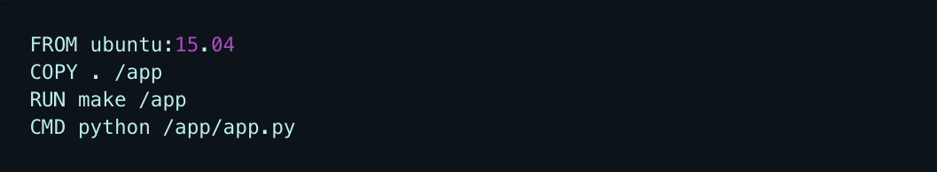
Layered FS
Images and Layers
A Docker image is built up from a series of layers. Each layer represents an instruction in the image’s Dockerfile. Each layer except the very last one is read-only. Consider the following Dockerfile
Layer 1
Layer 2
diff
Layer 3
Layer 4
Each layer is only a set of differences from the layer before it. The layers are stacked on top of each other. When you create a new container, you add a new writable layer on top of the underlying layers. This layer is often called the “container layer”. All changes made to the running container, such as writing new files, modifying existing files, and deleting files, are written to this thin writable container layer.

Slide 35
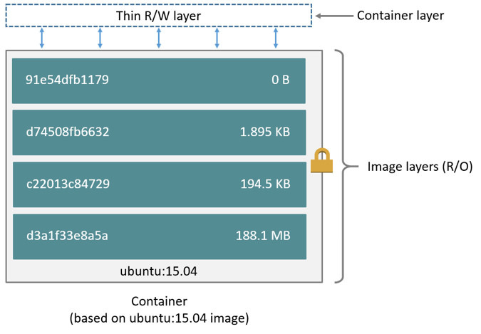
Layered FS
R/O !

Slide 36
Layered FS
Containers and Layers
The major difference between a container and an image is the top writable layer. All writes to the container that add new or modify existing data are stored in this writable layer. When the container is deleted, the writable layer is also deleted. The underlying image remains unchanged. Because each container has its own writable container layer, and all changes are stored in this container layer, multiple containers can share access to the same underlying image and yet have their own data state. The diagram below shows multiple containers sharing the same Ubuntu 15.04 image.

Slide 37
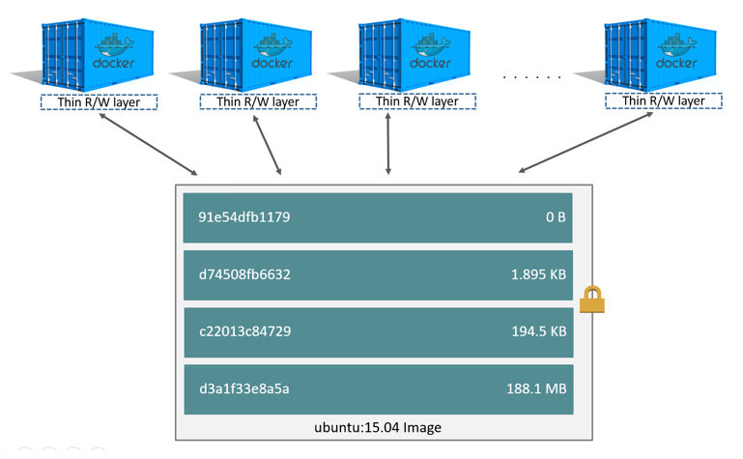
Layered FS
Different Containers
Using same Image
Note: If we need multiple images to have shared access to the exact same data, we store this data in a Docker volume and mount it into your containers.

Slide 38
Building docker images with Dockerfile

Slide 39
Getting Started
“Docker can build images automatically by reading the instructions from a Dockerfile. A Dockerfile is a text document that contains all the commands a user could call on the command line to assemble an image. Using docker build users can create an automated build that executes several command-line instructions in succession “
Getting started with Dockerfile
Creating a Docker file
Building a image
Publish an Image to Docker Hub

Slide 40
Dockerfile
What will we do in this module?
Get our source code into a custom built image (vs pre-built images) to share with others

Slide 41
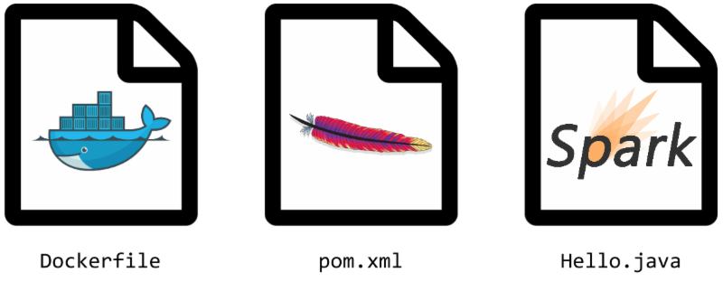
Dockerfile
Dockerfile is a … FILE with instructions and descriptions of an image
BUILD | Boot | Run
FROM | WORKDIR | CMD
 | USER | ENV
COPY |  | EXPOSE
ADD |  | VOLUME
RUN |  | ENTRYPOINT
ONBUILD
.dockerignore

Slide 42
How it works?

Slide 43
Dockerfile - flow
Creating Text file with instructions
+
Build process sends the entire context to Daemon recursively
=
Docker Image Created
Docker IMAGE created
Warning: Do not use your root directory, /, as the PATH as it causes the build to transfer the entire contents of your hard drive to the Docker daemon.

Slide 44
Dockerfile - Example
‹#›
© All rights reserved to John Bryce Training LTD from Matrix group

Slide 45
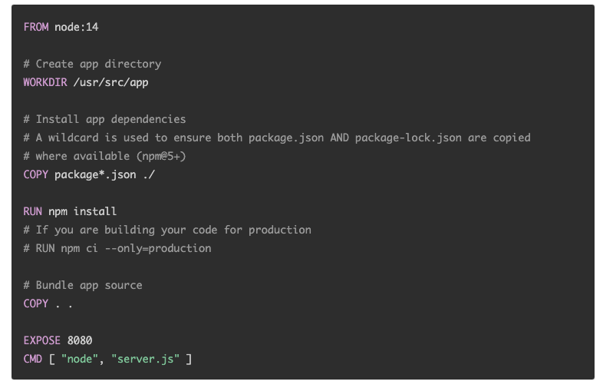
‹#›
© All rights reserved to John Bryce Training LTD from Matrix group

Slide 46
Dockerfile
Dockerizing Node.js Applicaiton
DOCKERFILE

Slide 47
Create Node.js Application Or use Existing
Package.json
{
"name": "nodejs-docker-app",
"version": "1.0.0",
"description": "Node.js on Docker",
"author": "YOUR NAME",
"main": "server.js",
"scripts": {
"start": "node server.js"
},
"dependencies": {
"express": "^4.16.1"
}
}
Run ‘npm install’

Slide 48
Create Node.js Application Or use Existing
Server.js
const express = require('express');
// Constants
const PORT = 3050;
const HOST = '0.0.0.0';
// App
const app = express();
app.get('/', (req, res) => {
res.send('Hello World');
});
app.listen(PORT);
console.log(`Running on http:localhost:${PORT}`);

Slide 49
Creating Docker file
1. Create a file named dockerfile
2. Next, we need to define from what image we want to build from
FROM node:20
3. Lets define the working directory
WORKDIR /usr/src/app
4. This image comes with Node.js and NPM already installed so the next thing we need to do is to install your app dependencies using the npm binary.
COPY package*.json ./
RUN npm install

Slide 50
Creating Docker file
1. Copy the application files from current folder to the working fir folder
COPY . /usr/src/app
3. Our application is bound to PORT 3050 so we need to expose it
EXPOSE 3050
4. Last we need define the run command for our application – this command will run when running the container and not building the image.
CMD [“node”, “server.js”]

Slide 51
Complete docker file
FROM node:14
WORKDIR /usr/src/app
COPY package*.json ./
RUN npm install
# If you are building your code for production
# RUN npm ci --only=production
COPY . /usr/src/app
EXPOSE 3050
CMD [ "node", "server.js" ]

Slide 52
Docker ignore
Create .dockerignore file with the following rows:
node_modules
npm-debug.log
2. The above configuration will prevent from copying unnecessary files into the docker build process

Slide 53
Building your image
Go to the directory that has your Dockerfile and run the following command to build the Docker image.
The -t flag lets you tag your image so it's easier to find later using the docker images command:
docker build . -t nodejs-app

Slide 54
Running your container
Running your image with -d runs the container in detached mode, leaving the container running in the background.
The -p flag redirects a public port to a private port inside the container. Run the image you previously built:
docker run -p 3050:3050 -d nodejs-app

Slide 55
Test your container
1. Browse to http://localhost:3050/ - and see the web page
2. Run ‘docker ps’
3. Run ‘docker logs <containerId>’
4. Enter the docker, run ‘docker exec –it <containerId> /bin/bash’

Slide 56
Docker Volumes

Slide 57
Volumes
What is a Volume
Special type of directory in a container typically referred to as a “data volume”
Can be shared and reused among one or many containers
Updates to an image won’t affect a data volume
Data volumes are persisted even after container deletion
Volumes are OS agnostic. They can run on Linux and windows containers
Volumes drivers allow us to store volumes on remote hosts or cloud providers.
Volumes can be encrypted or to add other functionality
A new volume content can be pre-populated by a container

Slide 58
Volumes
Create and manage volumes:
What will we achieve in the following follow through session:
Creating new volume
Inspect
Removing
Start a container[s] with a volume

Slide 59
STOP AND REMOVE
CLEAN UP

Slide 60
CONTAINERS IN PRODUCTION
CONS / PROS AND INBETWEEN
And No...deploying your app inside a container - does not change it’s monolith architecture to microservices

Slide 61
CONTAINERS IN PRODUCTION
Containers
Containers are amazing peace of technology but like anything and everything else,
There are no such thing as a free lunch.
There are many benefits that we learned about using containers and how it can make our development / deployment / CI / CD easy and fast but a question should be asked…
What’s the catch ?

Slide 62
CONTAINERS IN PRODUCTION:PROS
Containers makes our applications "virtually look" the same on most infrastructures (Physical/Cloud/VM’s)
Containers makes our application runtime dependencies the developers's responsibility - splendid!
Containers require the application developers to consider application state and persistence.
Containers, once built, provide a (mostly) consistent behavior between dev, staging, and production environments. Immutable delivery mechanism out of the box
Blazing fast scaling our ecosystem
Delivery time - Days and hours becomes minutes / seconds
Handoff - Developers <> Operators - Wall of confusion ? breached!
The above makes using Containers a no brainer for production - But there are flaws we should know about

Slide 63
CONTAINERS IN PRODUCTION:CONS
Containers do not make your applications more secure.
Containers do not make your applications more scalable - This is a common misconception
Containers do not make your applications more portable - Shared / Common libraries in your code?
Network - NAT managed by Dockerd is not how we want to work in production

Slide 64
Volume example
Clone the following git repo:
https://github.com/galamo/node-app-winston-docker
Follow the readme.md
Docker build
Docker run with volume option

Slide 65
NETWORKING

Slide 66
Network - Basics
Intro
One of the reasons Docker containers and services are so powerful is that you can connect them together, or connect them to non-Docker workloads. Docker containers and services do not even need to be aware that they are deployed on Docker, or whether their peers are also Docker workloads or not. Whether your Docker hosts run Linux, Windows, or a mix of the two, you can use Docker to manage them in a platform-agnostic way.

Slide 67
Network - Basics
Network Driver Summary
Bridge
User-defined bridge networks are best when you need multiple containers to communicate on the same Docker host.
Overlay
are best when you need containers running on different Docker hosts to communicate, or when multiple applications work together using swarm services - Works with Swarm only
macVLAN
Macvlan network are best when you are migrating from a VM setup or need your containers to look like physical hosts on your network, each with a unique MAC address

Slide 68
Before we continue
DOCKERS Q&A
REVIEW / STRATEGY / CI/CD

Slide 69
Docker Compose

Slide 70
Docker Compose
Intro
“ Compose is a tool for defining and running multi-container Docker applications…
…. With Compose, you use a YAML file to configure your application’s services. Then, with a single command, you create and start all the services from your configuration. “

Slide 71
Docker compose
When should we use it?
Development environment
When you’re developing software, the ability to run a full fledged application (role and all of its dependencies) in an isolated environment and interact with it is crucial. The Compose command line tool can be used to create the environment and interact with it.
Using the Compose file - we can document and configure all of the application (role) depenendencies (DB, Queues, Caches, web services API and many other components) in one of multiple containers per component in a single command (docker-compose up)
Compose can provide a convenient way for developers to focus on developing and not on requesting servers or waiting for IT to provide VM’s , EC2’s or physical servers to develop on top.

Slide 72
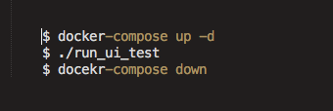
Docker compose
When should we use it?
Automated Tests environment (as part of a ci/cd or standalone)
With compose we can run end-to-end testing that requires a full environment for it to run.
Compose provides a convenient way to create , destroy an isolated testing environments for our test suite.
Vision this:

Slide 73
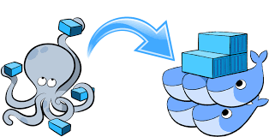
Docker compose
Docker compose manges our application lifecycle

Slide 74
Docker compose
Docker compose manges our application lifecycle
Start, stop , rebuild of our services
View status of our running services
Stream the log output of running services
Run a one-off command on a service

Slide 75
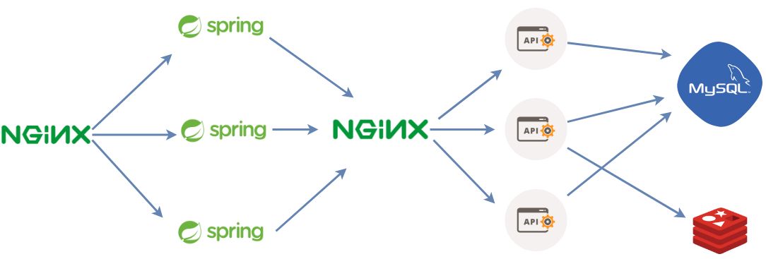
Docker compose
Why do we need docker compose?
Imagine managing this manually

Slide 76
Docker compose
Why do we need docker compose?
Using docker-compose.yml we can define
Networking
Dependencies between services
Environments
What makes up a role and its components
Manage each application services we got

Slide 77


Docker compose
Docker compose flow
Build Services
(dockerfiles)
Start our services
Take them down
Generate images

Slide 78
Docker compose
Layout
Docker compose is basically 3 steps process
First we define our app/role environment with a dockerfile as we did earlier
Define the services/components that makes our app/role a whole in our compose file “docker-compose.yml”
Run “docker-compose up”
----- Multiple images are up and running

Slide 79
Docker Compose
.yml example

Slide 80
version: '3' # Docker-compose yml version for docker compose builder services: # Here we define our architecture services / roles nginx: # or web_role , api_role , db_mysql , db_redis .... build: # Dockerfile to build or use image: to pull from DockerHub (public/private) or git context: . # folder where the dockerfile is located dockerfile: #[dockerfile-name] ports: # Ports we wish to expose source:target - 8080:8080 volumes: # Which Bind mounts or Volumes to mount source:target - type: bind # Shortsyntax -> ./source:/code source: /source target: /code -type: volume # Shortsyntax -> logicalVolume01:/var/log source: logicalVoloume01 target: /var/log network: # Define netwroks per service / role - db_layer - app_layer networks: # custom configuration per network defined db_layer: app_layer: volumes: logicalVoloume01:

Slide 81
Installing Docker Compose: sudo curl -L "https://github.com/docker/compose/releases/download/1.22.0/docker-compose-$(uname -s)-$(uname -m)" -o /usr/local/bin/docker-compose sudo chmod +x /usr/local/bin/docker-compose

Slide 82
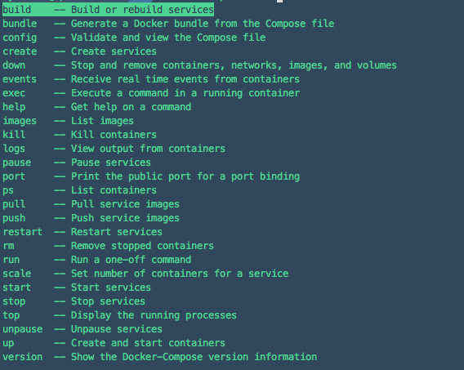
Docker compose
Common cli for docker compose lifecycle

Slide 83
CLEAN UP
docker-compose rm -f -v -s

Slide 84
